Slide 1

Finding Fuzzy-Rough Reducts with Fuzzy Entropy
Neil Mac Parthaláin
Richard Jensen
Qiang Shen
Advanced Reasoning Group
Department of Computer Science
Aberystwyth University,
Aberystwyth
CYMRU / WALES

Slide 2
Overview
Less is More - Feature Selection and Rough Sets
Fuzzy-Rough Sets and Feature Selection
Fuzzy Entropy
Finding Reducts using Fuzzy Entropy
Results
Conclusion & Future work
Notes:
Start with an overview to the talk

Slide 3
Less is More
Ever-growing amounts of data
Data ≠ Information
Reduction of data by removing irrelevant and redundant parts
Less is More - make the data less in order to gain more useful findings
Notes:
1) May have many names

Slide 4
Dimensionality Reduction
Feature Selection
Many advantages:
  Easier for classifiers to learn from the data
  Improvement in data presentation/visualisation
  Reduction in storage/measurement reqs.
  Others also: noise reduction, rule induction, prediction performance etc.

Slide 5
Rough Sets
Extension of conventional set theory that allows approximations in decision making
Data driven – no human intervention required
Two basic concepts:
  Lower Approximation - definite
  Upper Approximation - possible
Also Boundary region

Slide 6
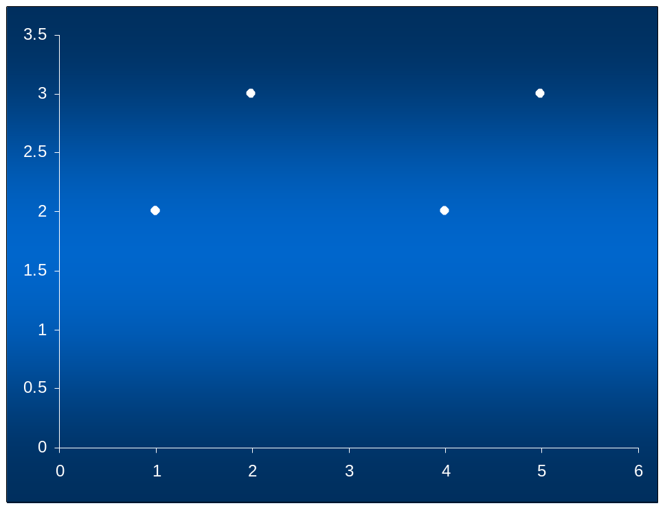

Rough Sets (2)
P = {f1, f2}
obj | f1 | f2 | decision
x1 | 2 | 1 | ●
x2 | 3 | 2 | ●
x3 | 2 | 4 | ▲
x4 | 3 | 5 | ▲
x5 | 2 | 1 | ●
U/P {{x1,x5}, {x2},{x3},{x4}}
U/decision ={{x1,x2,x5},{x3,x4}}

Slide 7
Rough Sets
Problem:
Cannot handle real-valued data!
Solution:
Extend rough set model
  Variable Precision Rough Sets - VPRS,
  Tolerance Rough Set Model - TRSM
  are all alternatives but; require thresholding value!
Fuzzy-Rough sets: data-driven

Slide 8
Fuzzy Rough Sets

Slide 9
Fuzzy-rough Sets
Fuzzy-rough set theory is an extension of rough set theory
Rough set theory unable to deal with real valued/noisy data. Membership is {0,1}
Fuzzy-rough hybrid overcomes this allows membership of [0,1] thus allowing greater flexibility in handling real-world attributes
Fuzzy Equivalence Classes central to Fuzzy-rough approach
Decision and conditional values allowed to be fuzzy
Inclusion of a fuzzy similarity relation determines the extent to which two elements are similar

Slide 10
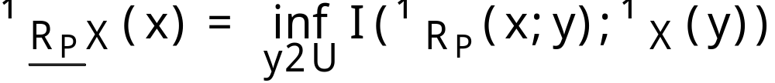
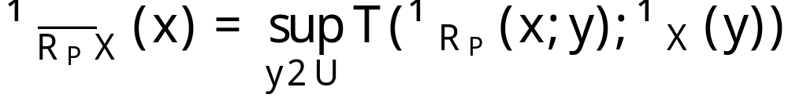
Fuzzy-rough Sets
A fuzzy-rough set is defined by two fuzzy sets:
- Fuzzy Lower Approximation:
- Fuzzy Upper Approximation:
These are equivalent to the crisp (rough) counterparts in rough set theory

Slide 11
Fuzzy-Rough Feature Selection

Slide 12
Measures in Fuzzy-Rough Feature Selection
Current Measures:
Fuzzy Dependency
<Fuzzy Dependency Example>
Uses Fuzzy Positive Region – information of the Fuzzy Lower Approximation
Information of the Fuzzy Boundary Region?

Slide 13
Measures in Fuzzy-Rough Feature Selection (2)
Existing work has employed Boundary Region information – e.g. Distance measure for RS
Fuzzy Entropy also used in existing work
Why not employ Fuzzy Entropy measure considering Boundary Region information

Slide 14
Measures in Fuzzy-Rough Feature Selection (3)
Measures Employed:
  Minimise Fuzzy Boundary Region
  Fuzzy Entropy of the Boundary Region
  Fuzzy Gain Ratio

Slide 15
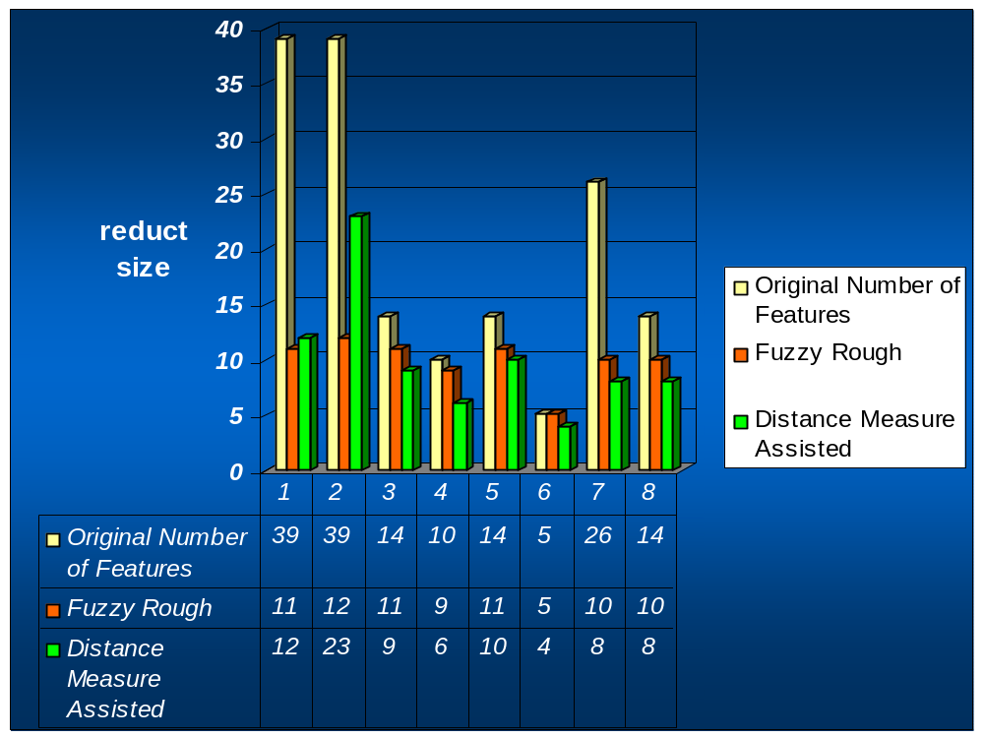
Experimentation & Results
Reduct size:
DMRSAR approach on average performs significantly better than Fuzzy-rough method
Reduction in reduct size up to 40% recorded over Fuzzy-rough method

Slide 16
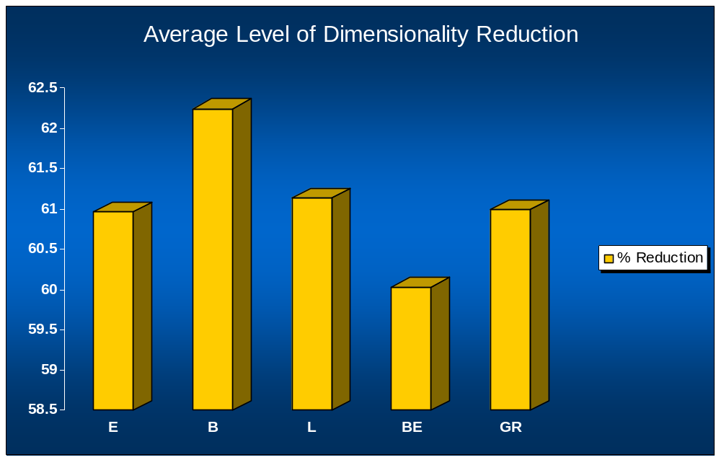
Experimentation & Results (2)
Minimisation based on the Fuzzy Boundary Region performs best
Both Lower Approximation methods perform similarly
Fuzzy Gain Ratio is comparable to the Lower Approximation method

Slide 17
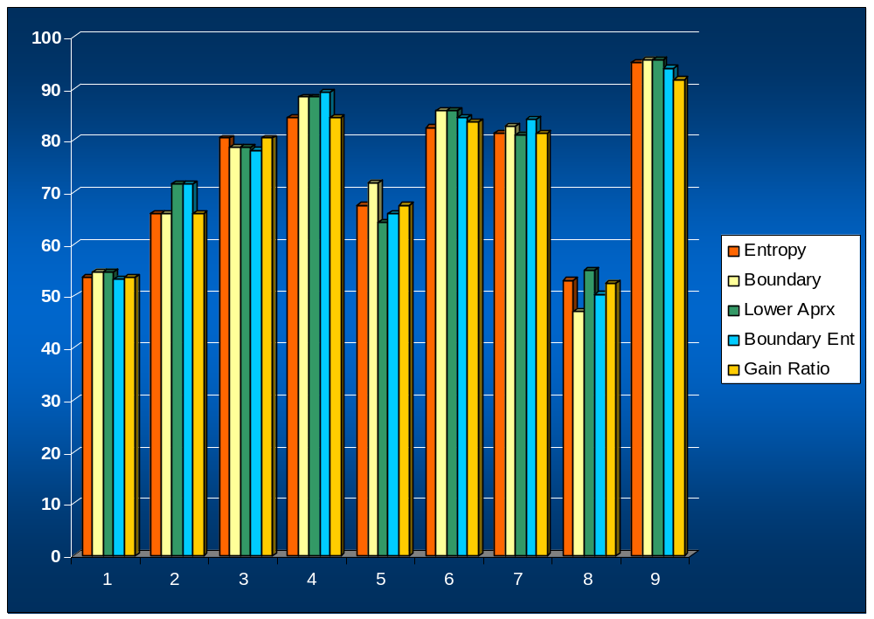
Experimentation & Results (2)
Classification:
    Similar performance to fuzzy-rough method.
    Fuzzy-rough method also suffers from small decreases when compared to unreduced data
    Decreases insignificant when compared to overall increase in dimensionality reduction

Slide 18
Conclusion
Overall the distance-assisted rough set method offers improvements in performance in terms of:
Reduct size – up to 40%
Classification – small but significant considering corresponding level of dimensionality reduction
Runtimes – considerably faster than Fuzzy-rough

Slide 19
Conclusion
Much scope for further research
    Fuzzification of the boundary region distances
    Re evaluation of mean lower approximation calculation
    Development of a distance measure-assisted TRSM Approach
    Alternatives to greedy forward selection
    Investigate effect of different threshold values on subset size
    Development of a fuzzy Hausdorff distance version

